Slide 1





Responsible sourcing of rare earth elements
Resource scarcity workshop, East Kazakhstan
State Technical University
Robert Pell
Camborne School of Mines (University of Exeter)

Slide 2
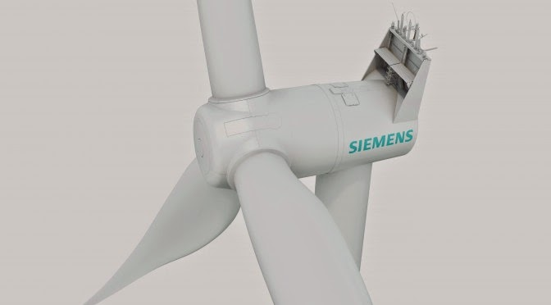
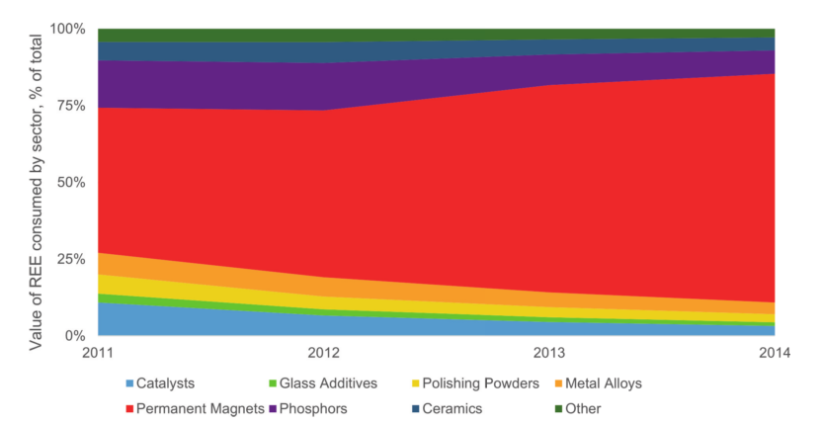

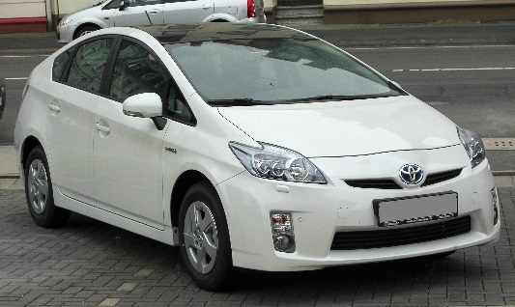
Rare earth element applications
Figure 1. Proportional value of REO consumed by various industries from 2011-2014 (Industrial Minerals Company of Australia, 2014)
‘Quantifying the environmental performance of rare earth production using life cycle assessments’
Notes:
REE distributed widely across the world
Difficult to extract and purify

Slide 3
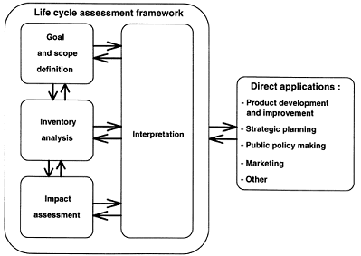
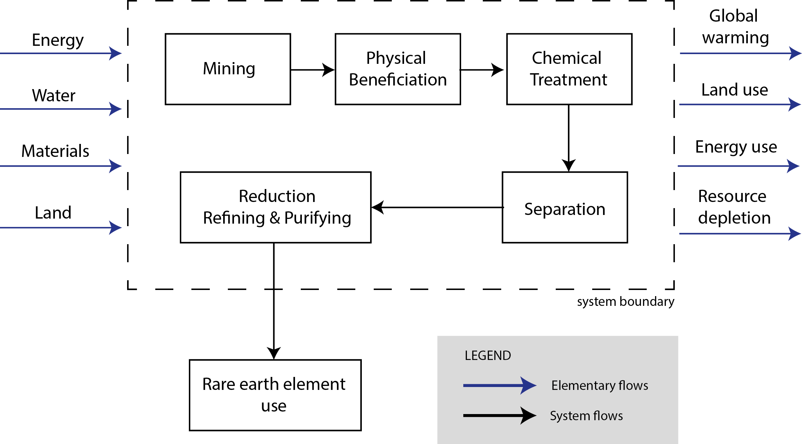
Life Cycle Assessment
A Life Cycle Assessment allows a quantitative assessment of the environmental performance of a product or process over its entire life cycle
Figure 2. Life cycle assessment framework (GaBi 6.0 , 2015)
Figure 3. Simplification of flows in and out of a rare earth element production process

Slide 4
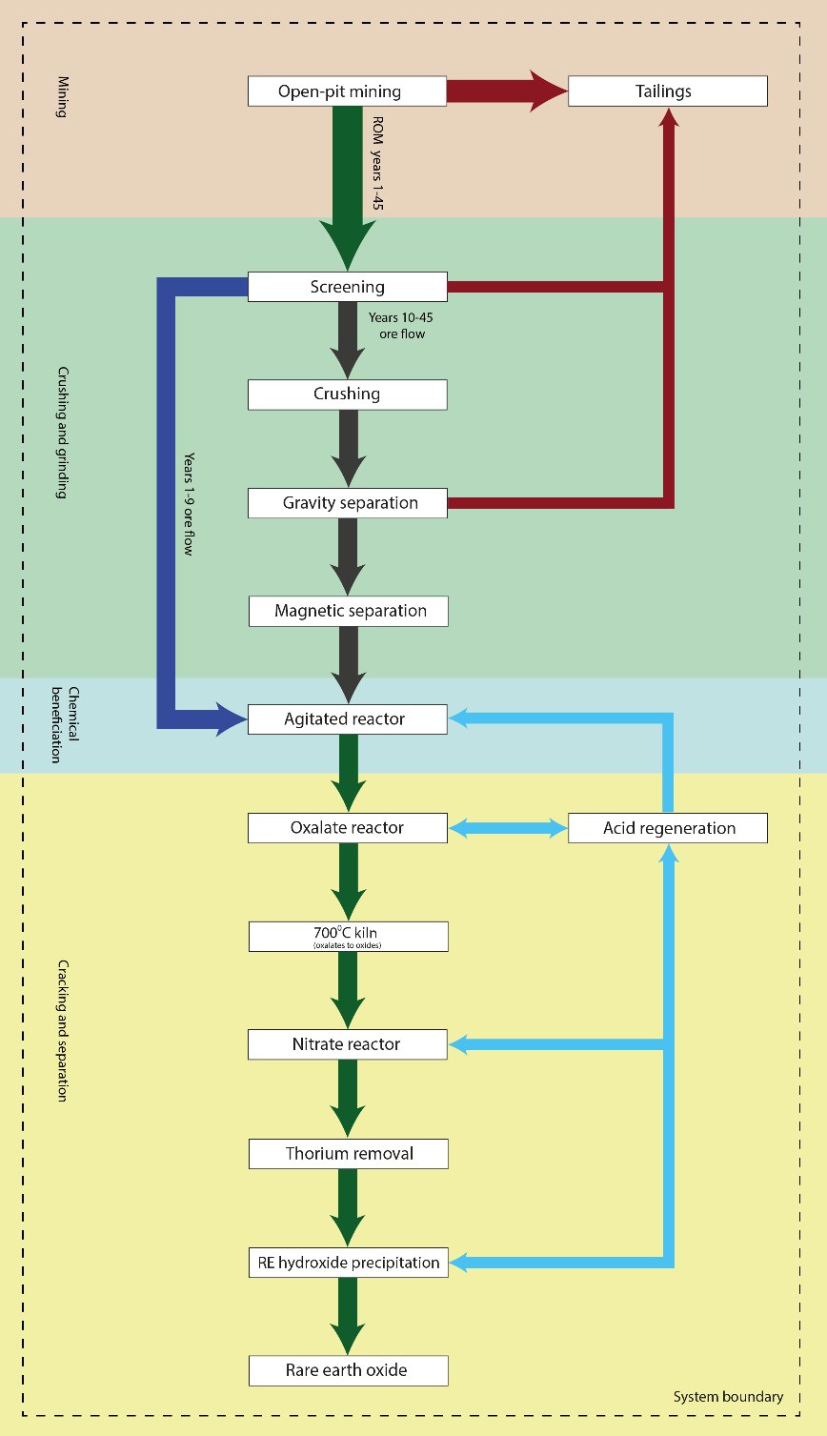
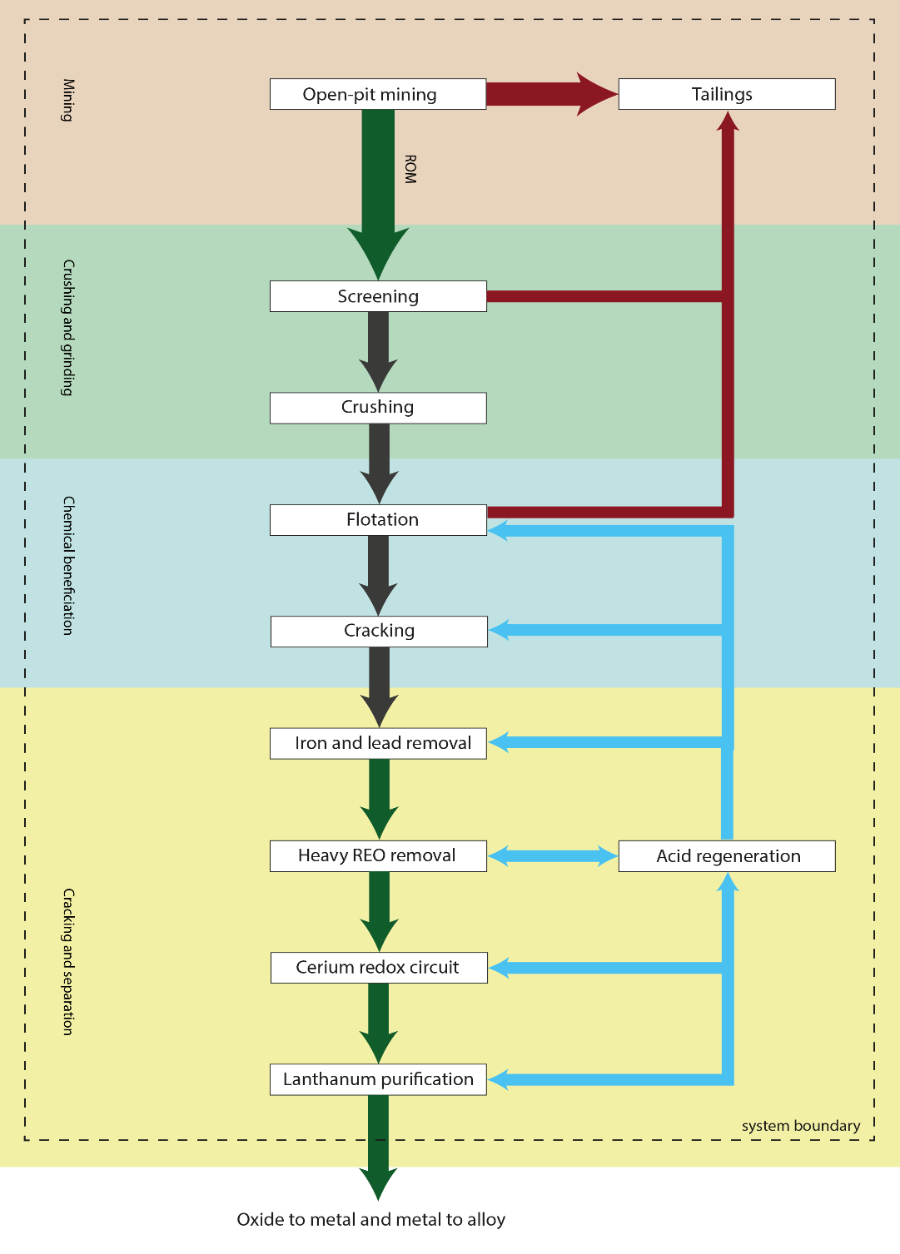
Processes and flowsheet at Bear Lodge
Processes and flowsheet at Mountain Pass
Mining
Crushing &
grinding
Chemical
beneficiation
Cracking &
separation

Slide 5
Energy contribution (MJ/kg REO) during the production of REOs at Mountain Pass and Bear Lodge during phase 1 and 2 of development
65.44
22.29%
MJ/kg REO at Bear Lodge (yrs 1-9)
Percentage of total energy consumed
during flotation at Mountain Pass
80.22
MJ/kg REO at Bear Lodge (yrs 10-45)
70.88
MJ/kg REO at Mountain Pass
Figure 4. Energy use in production of REOs (MJ/kg REO) at Mountain Pass and Bear Lodge

